Slide 1
DCCDL Oral presentation
Date: 12/23
組員: 林豪澤 、吳瑋恩

Slide 2
Outline
Topic
Plan to complete
Schedule
Block diagram
how to do it
what you have done

Slide 3
Topic
64-point radix-4 FFT using single path delay feedback (SDF) including bit-reversal buffers with SQNR more than 45dB.
Team members: 林豪澤、吳瑋恩

Slide 4
plan to complete
Paper Reading and some research (both)
Timing diagram and block diagram building (both)
Matlab simulation (both)
Verilog simulation (both)
FPGA measurement

Slide 7
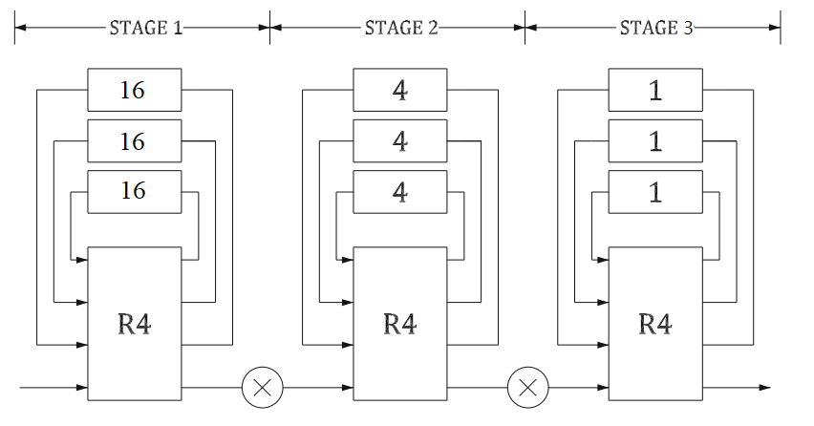
Block diagram
Notes:
N = $R^{S}$ (N= points, R = radix, S = stage)
64-points = (radix-4)^(3 stages)
32-points = (radix-2)^(5 stages)

Slide 8

Block diagram
$$N= R^{s}$$
$$32=2^{5}$$
$$64= 4^{3}$$
Notes:
N = $R^{S}$ (N= points, R = radix, S = stage)
64-points = (radix-4)^(3 stages)
32-points = (radix-2)^(5 stages)

Slide 9
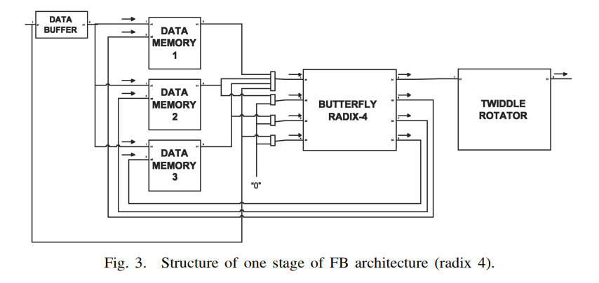
Block diagram – first stage
Sanchez, M., Garrido, M., L ´ opez, M., & Grajal, J. (2008). ´ Implementing FFT-based digital channelized receivers on FPGA platforms. IEEE Trans. Aerosp. Electron. Syst., 44(4), 1567–1585.

Slide 10
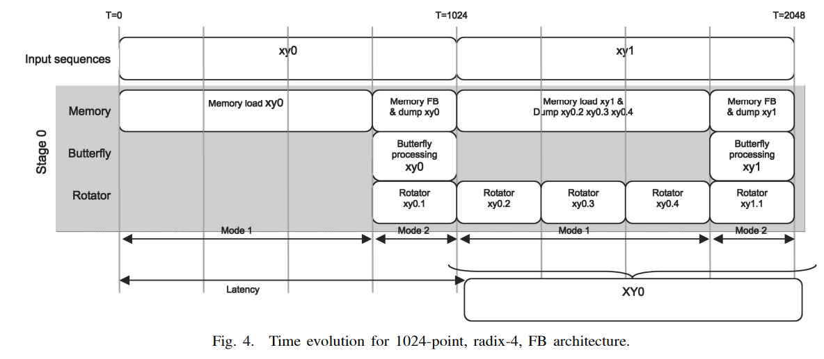
Time evolution

Slide 11
Time evolution

Slide 12
Block diagram – first stage
T= 0~15
Point: 0~15

Slide 13
Block diagram – first stage
T= 16 ~ 31
Point: 16~31
Point: 0~15

Slide 14
Block diagram – first stage
T= 32 ~ 47
Point: 32~47
Point: 0~15
Point: 16~31

Slide 15
Time evolution

Slide 16
Block diagram – first stage
T= 48~63
Point: 0~15
Point: 16~31
0
16
32
Point: 32~47
48
Point: 48~63

Slide 17
Time evolution

Slide 18
Block diagram – first stage
T= 48~63
Point: 16~31
Point: 0~15
Point: 32~47
Point: 48~63
Point: 48~63

Slide 19
Time evolution

Slide 20
Block diagram – first stage
T= 48~63
Point: 16~31
Point: 0~15
Point: 0~15
Point: 32~47
Point: 48~63
Point: 48~63

Slide 21
Thank you~

